Slide 1
.NET Core Web API
Day14
REFS#201 and fixes #201

Slide 2
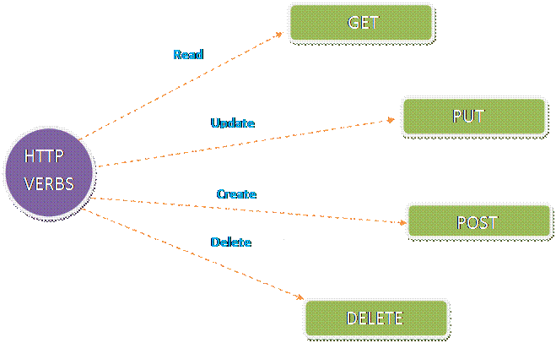
Here I will explain about Http Get, Put, Post and Delete verbs in ASP. Net Web API in detail.

Slide 3
CRUD BASICALLY DEPENDS ON THIS FOUR METHOD :
C - Create - POST R - Read - GET U - Update - PUT D - Delete - DELETE

Slide 4
HTTPGET
Get methods are for getting data from Web API, which allow API consumer to fetch data from API
As per the Web API naming convention, action method that starts with a work "Get" will handle HTTP GET request.
Get method returns what are the strings assigned in the languages variable. Get method contains the code, which looks, as shown below.
// GET api/values
public IEnumerable<string> Get()
{
return languages;
}

Slide 5
Continue..
If need arises, you can get the specified string from the list. We can get it, using Get method with the parameter. Here, Get method contains overload.
Like example :
public string Get(int id)
{
return languages[id];
}

Slide 6
HTTPPOST
The HTTP POST request is used to create a new record in the data source in the RESTful architecture
The action method that will handle HTTP POST request must start with a word Post.
It can be named either Post or with any suffix e.g. POST(), Post(), PostNewABC(), PostAbc() are valid names for an action method that handles HTTP POST request.

Slide 7
Example:- to insert new student record in the database using Entity Framework.
public IHttpActionResult PostNewStudent(StudentViewModel student)
{
using (var ctx = new SchoolDBEntities())
{
ctx.Students.Add(new Student()
{
StudentID = student.Id,
FirstName = student.FirstName,
LastName = student.LastName
});
ctx.SaveChanges();
}

Slide 8
Continue…
As you can see above, we named action method as PostNewStudent. You can give any name as per your requirement but it must start with the word "Post". The PostNewStudent() action method includes parameter of StudentViewModel type which includes all the information about new student.
Next, implement Put action method to handle HTTP PUT request in the Web API.

Slide 9
HTTPPUT
The HTTP PUT method is used to update an existing record in the data source in the RESTful architecture.
The action method that will handle HTTP PUT request must start with a word Put. It can be named either Put or with any suffix e.g. PUT(), Put(), PutNewAbc(), PutAbc() are valid names for an action method that handles HTTP PUT request.

Slide 10
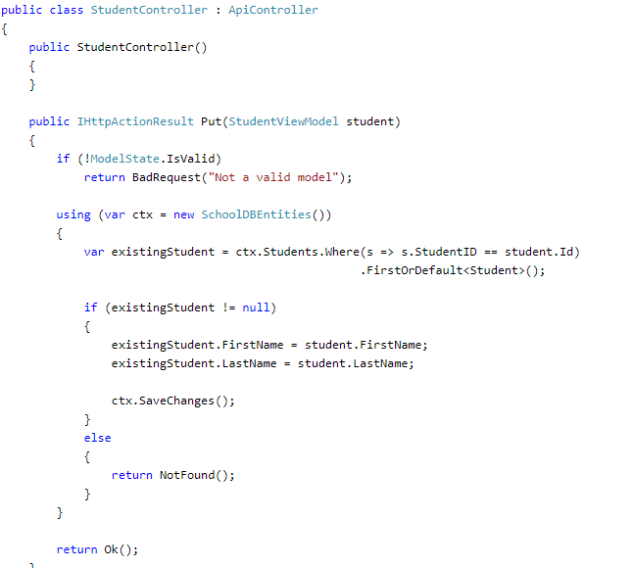

Slide 11
Continue…
As you can see in previous example, Put action method includes a parameter of StudentViewModel. It then creates new student entity using passed StudentViewModel object and then changes the state to be modified.
Next, implement Delete action method to handle HTTP DELETE request in the Web API.

Slide 12
HTTPDELETE
The HTTP DELETE request is used to delete an existing record in the data source in the RESTful architecture.
The action method that will handle HTTP DELETE request must start with the word "Delete". It can be named either Delete or with any suffix e.g. DELETE(), Delete(), DeleteAbc(), DeleteAllAbc() are valid names for an action method that handles HTTP DELETE request.

Slide 13
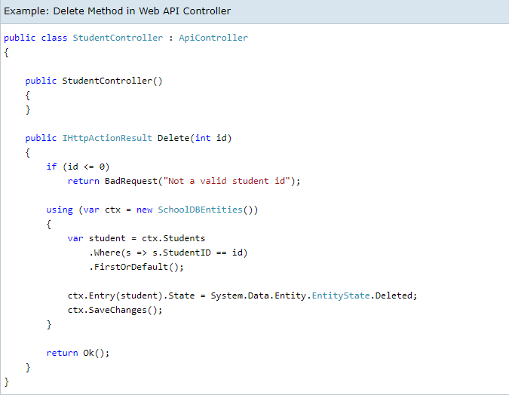

Slide 14
Continue…
Delete action method includes an id parameter of int type because it just needs an id to delete a record.
It fetches an existing student from the database that matches with the specified id and then marks its status as deleted. This will delete a student from the database.
Thus you can create Get, Post, Put and Delete methods to implement HTTP GET, POST, PUT and DELETE requests respectively.

Slide 15
Repository Pattern in .NET core web API
What is Repository Pattern?
Repository Pattern is an abstraction of the Data Access Layer. It hides the details of how exactly the data is saved or retrieved from the underlying data source.
The details of how the data is stored and retrieved is in the respective repository.

Slide 16
Repository Pattern Interface
The data required for each of the operations i.e. the parameters that need to be passed to the method and the data the method returns
The repository interface contains what it can do, but not, how it does, what it can do
The implementation details are in the respective repository class that implements the repository Interface
public interface IEmployeeRepository
{
Task<IEnumerable<Employee>> GetEmployees();
Task<Employee> GetEmployees(int employeeID);
Task<Employee> AddEmployee(Employee employee);
Task<Employee> UpdateEmployee(Employee employee);
void DeleteEmployee(int employeeId);
}

Slide 17
IEmployeeRepository interface supports the following operations
Get all the employees
Get a single employee by id
Add a new employee
Update an employee
Delete an employee

Slide 18
Thank You!

